Slide 1
Funding Outlook for the Housing Choice Voucher Program
Barbara Sard
Forum on Impact of Sequestration
November 1, 2013

Slide 2
HCV Funding Policy
Prior to 2003, PHAs generally received renewal funding annually for all authorized vouchers combined with administrative fees for all vouchers used.
To save money, in 2003 Congress began a policy of funding only authorized vouchers in use, and restricted uses of administrative fees to program-related purposes.
In 2004 – 2006, funding policy was more like a block grant, pegged to voucher costs at a prior point in time.
Beginning in 2007, Congress initiated a hybrid policy of basing renewal funding on the cost of authorized vouchers used in the prior year, plus inflation.
Renewal prorations in 2007 – 2012 varied from high of 105% to low of 98.8% in 2011.
Notes:
Year, Renewal Proration
2012 99.6%
2011 98.81%
2010 99.5%
2009 99.1%
2008 101.453%
2007 105.017%
2006 94.6%
2005 95.9%

Slide 3
The Budget Control Act of 2011 (BCA)
Set binding caps on “discretionary” spending in each fiscal year from 2012 to 2021, with separate sub-caps for defense and non-defense programs.
Triggered “sequestration” when Congress failed to agree on at least $1.2 trillion more in deficit reduction. Requires (i) automatic, across-the-board cuts in non-exempt entitlement and discretionary programs in FY 2013, and (ii) cuts in FY 2014 – 2021, including by lowering the defense and nondefense discretionary spending caps.
Notes:
Since the 2010 elections, Congress and the Administration have been engaged in a monumental battle over federal fiscal policy that has huge ramifications for the economy, the role of the federal government in many areas, and the well-being of low-income families. Result over past 3 years has been a swing towards austerity, beginning with funding cuts in FY 2011 and passage of the BCA.
Establishes tight caps on discretionary spending in each year, 2012 – 2021, with separate caps for defense and non-defense programs. Separate caps for D and ND are key to preventing further NDD cuts.
Sequestration. Deepens the cuts in non-exempt discretionary programs, beginning with ATB cuts in 2013, and then by lowering the spending caps in 2014 – 2021. [Also ATB cuts in non-exempt mandatory programs.]
[Many essential low-income programs – Medicaid and SNAP – are exempted, but VASH is only exempted low-income housing program.]
Sequestration is not a one-year thing: unless Congress acts to change the law, sequestration will reduce spending in 2014 and later years, as well as 2013. But sequestration reductions in 2014 – 2021 are not ATB.
BCA and sequestration cuts are front loaded in FY12 and FY13, but will continue to put enormous pressure on HUD budget in out-years.

Slide 4
3
Deficit Reduction Enacted Since 2010, Excluding Sequestration
$1.6 trillion in program cuts (mostly BCA
discretionary spending caps)
$0.7 trillion in revenues (“fiscal cliff” deal)
$0.5 trillion in interest savings
$2.8 trillion in total deficit reduction enacted
Notes:
1) The deficit reduction achieved since 2010 has been substantial:
Funding reductions for discretionary programs in the FY 2011 cycle
The BCA, which established tight discretionary spending caps for ten years
The “fiscal cliff” deal (ATRA), which made a series of changes in tax law
Total deficit reduction to date: $2.8 trillion over decade, including interest savings.
2) Deficit reduction thus far has relied heavily on program cuts – particularly discretionary program cuts – cutting spending by more than $2 for every $1 in additional revenues. About $900 billion in spending cuts from NDD programs, which include housing/CD.

Slide 5
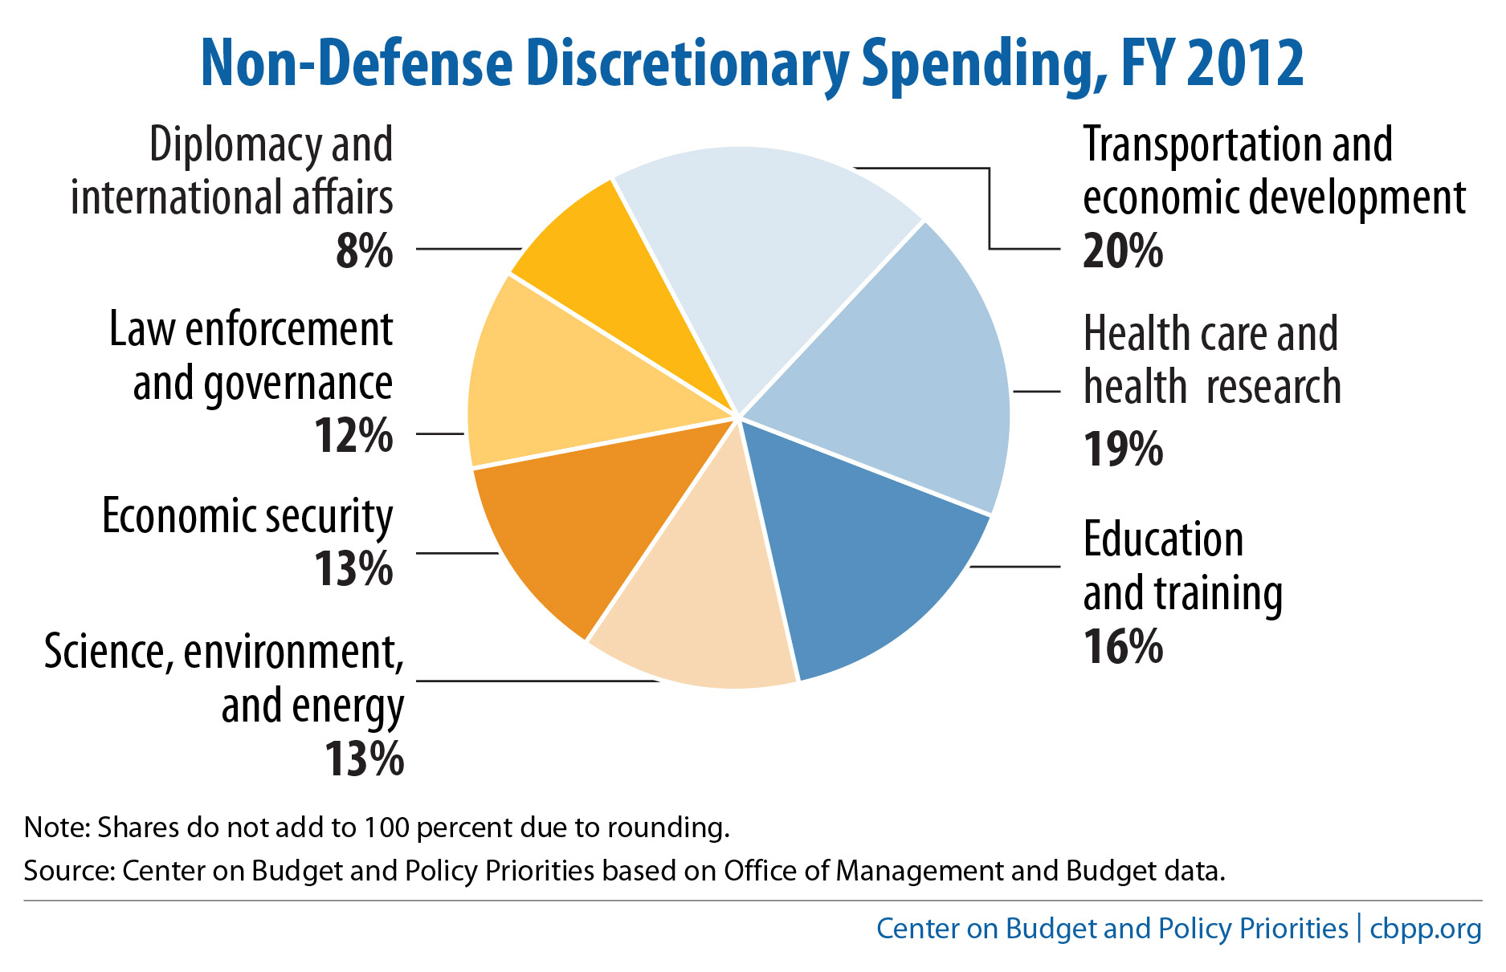
Notes:
“Economic security” is mostly housing assistance – about 60%.
In 2012, NDD spending totaled $616 billion, or 17 percent of federal spending. Of that total, 34 percent went to grants to states and localities, such as for K-12 education and highway projects, while 21 percent went to low-income programs, such as Head Start and low-income housing assistance. These categories are not mutually exclusive; a sizable share of grants to states and localities support low-income programs.

Slide 6
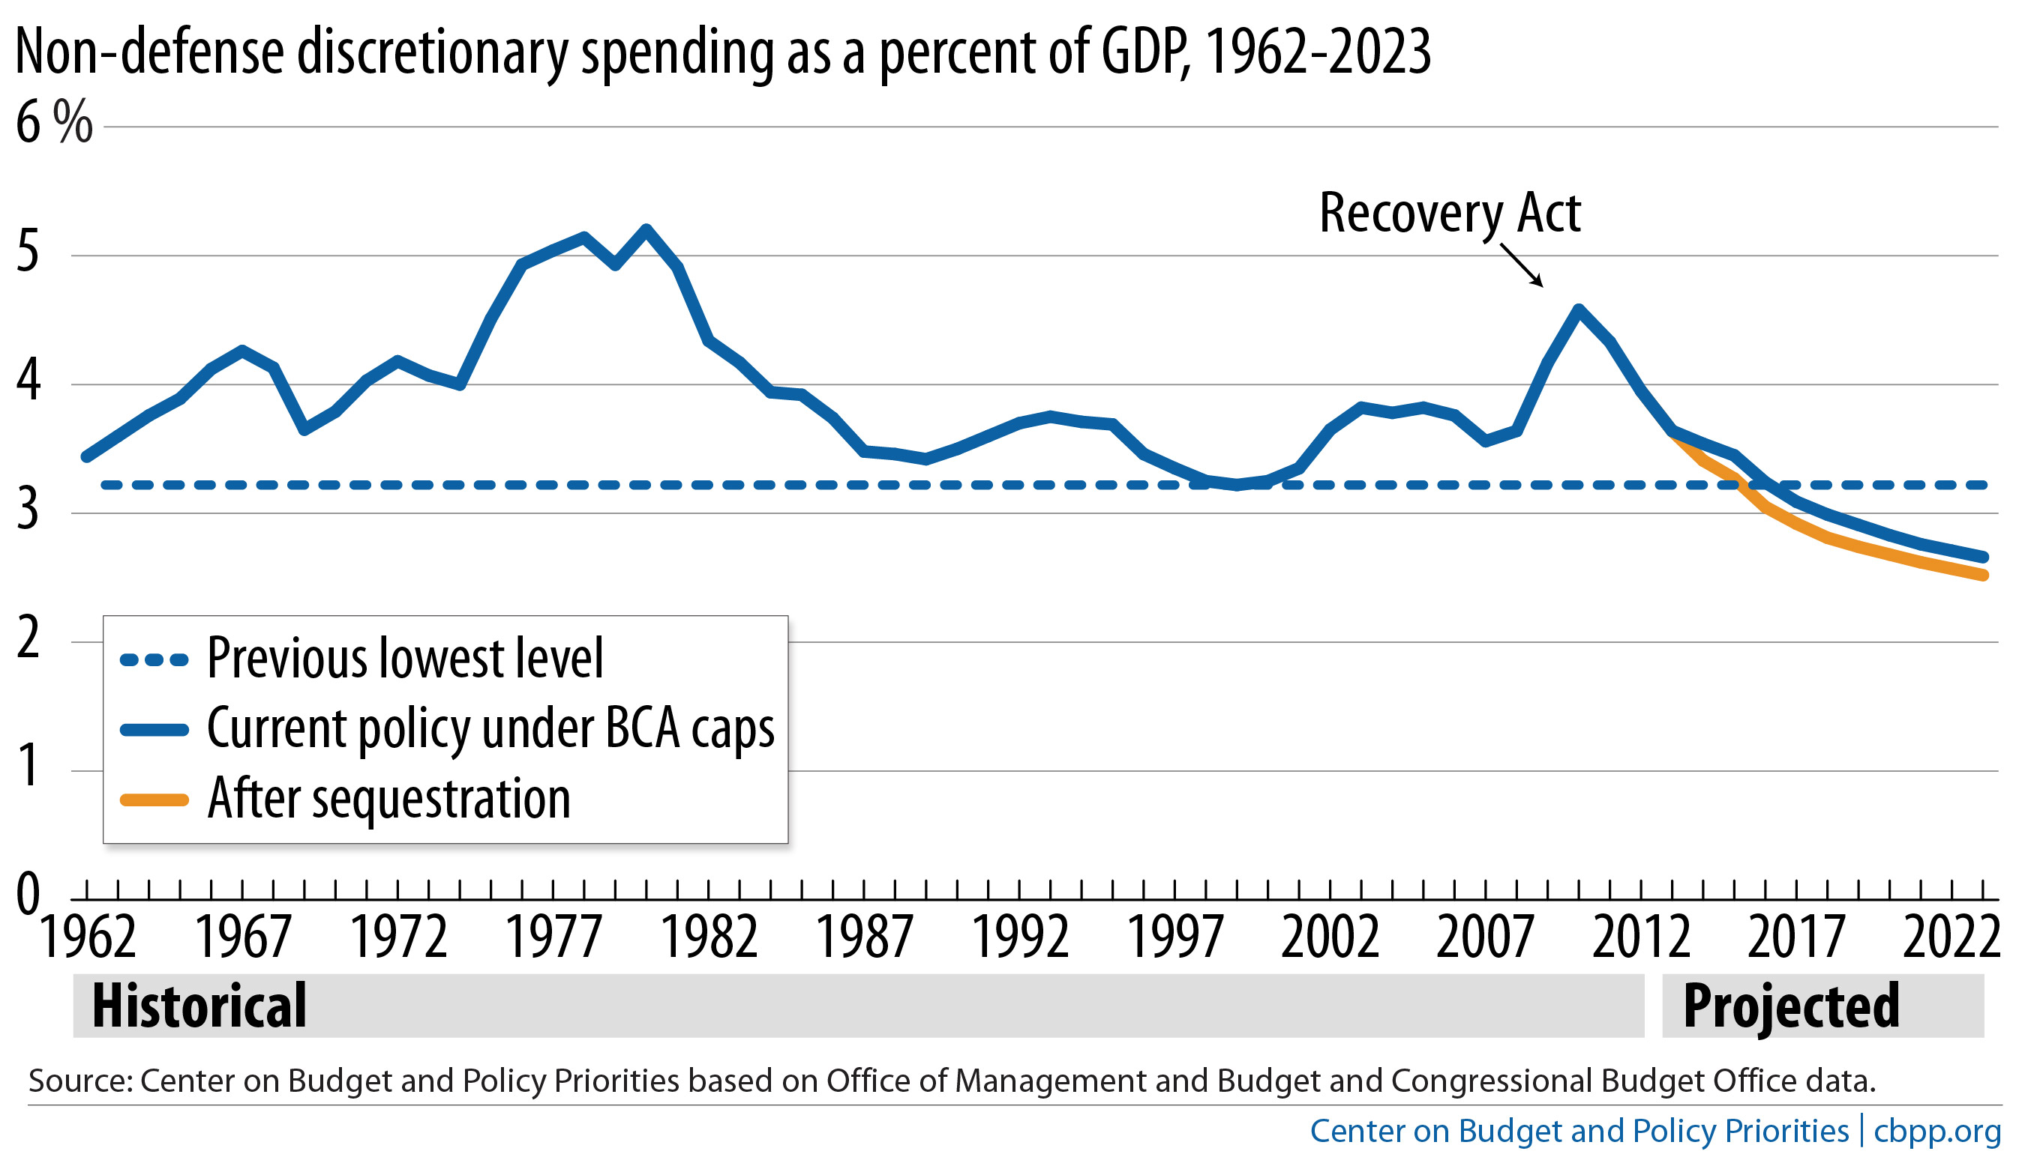
Nondefense Discretionary Program Spending Will Fall to Lowest Level on Record Under BCA Caps
Notes:
The cuts to discretionary programs are unprecedented. Under BCA, NDD spending will fall to its lowest level on record, as a share of GDP.

Slide 7
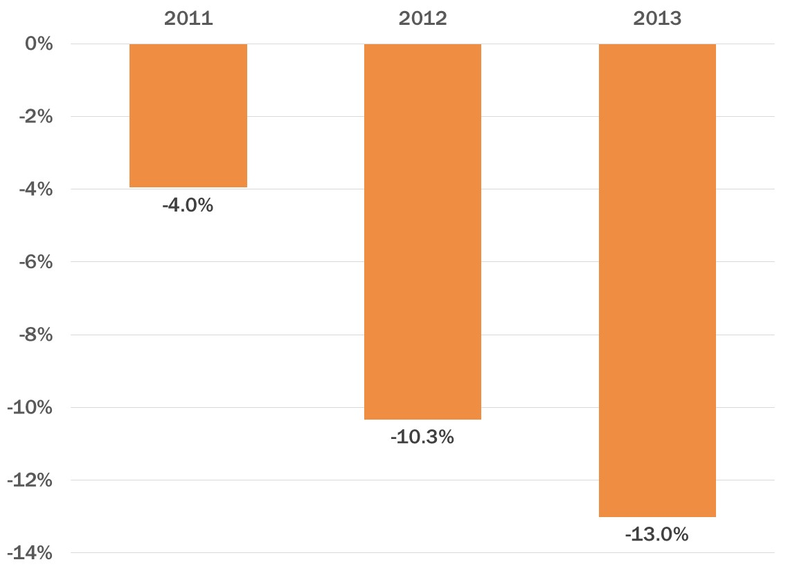
Three Waves of HUD Housing Assistance Cuts Since 2010
Percent cut in HUD housing assistance program funding,
relative to 2010, adjusted for inflation
Note: Sources are OMB and CBO data. Figures include discretionary HUD program funding for public housing, the Section 8 programs, homeless assistance, HOME, and smaller housing assistance programs, but not mortgage credit or community development programs.
Notes:
HUD housing assistance programs – a category that includes major rental assistance programs such as HCV and McKinney, but excludes CD and housing credit programs – have experienced 3 waves of cuts.
As of 2013, total funding for HUD housing assistance programs have fallen 13 percent relative to 2010, adjusted for inflation.

Slide 8
HCV 2013 Funding
PHAs’ CY13 renewal funding eligibility is based on leasing/costs in CY12, adjusted for inflation and other factors. (For MTWs, in accord with MTW agreement; generally pegged to a base year.)
PHAs will receive just 94% of CY13 renewal eligibility, an unprecedented shortfall. But allocations for Apr – Dec will average ~92%, as PHAs received higher amount in Jan – Mar.
$103M set aside to prevent terminations due to insufficient funds (and other purposes).
Administrative fees prorated at 69%.
Notes:
Read slide.
Explain proration: PHAs will receive about 8% less than need to make assistance payments for Apr – Dec, though actual gap depends on how well inflation factor used in formula anticipates actual changes in rents and tenant incomes. Gap could be lesser or greater for individual agencies.
Set aside funds may be used for:
Increased costs due to unforeseen circumstances or portability;
PBV commitments
VASH
Prevent terminations due to insufficient funding.

Slide 9
Prospects for FY 2014?
8
Congress has not agreed on overall discretionary funding levels for FY 2014. To end the shutdown, Congress enacted a Continuing Resolution (CR) through Jan. 14, 2014 at the FY13 post-sequestration level. Budget conference now underway; report due by Dec. 13.
Opportunity: Good deal could reduce or eliminate sequestration cuts – opening path for Congress to complete omnibus for FY 2014
Risk: Bad deal could replace sequestration with other cuts in entitlement safety net or NDD programs
Default option is full-year CR, with no changes in sequestration or discretionary funding caps; may include “anomalies” (i.e., funding adjustments)
Notes:
Congress’ goal…
Also, pressure is building to modify sequestration. Without changes, D would be cut by $20B in 2014. Bad for the economy. Hamstrings ability to make investments in core areas.
How might this play out? Two basic scenarios:
1) Budget deal that raises/suspends debt ceiling and replaces sequestration, at least in part, with alternative deficit reduction.
Opportunity: could eliminate/reduce sequestration cuts in NDD programs, and – if agreement can be reached by, say, end of November – open path to omnibus, including possible funding increases for core HUD programs.
Explain CR v. omnibus – Congress would negotiate and pass at least some of the 12 separate funding bills, including possibly THUD.
Risk (small): But also risk of replacing sequestration with other cuts in entitlement safety net or of modifying sequestration only on D side.
2) No broader budget deal, e.g., raise/suspend debt ceiling but make no changes in sequestration. Likely full-year CR, possibly with anomalies.
[Other issues in play: entitlement savings, revenues, but also ACA, budget process, Keystone XL pipeline.]

Slide 10
What Happens to Discretionary Funding
in FY 2014 Under the BCA Spending Caps?
2014 Discretionary Levels (billions of dollars)
 | Freeze at 2013 level after sequestration (CR) | Budget Control Act cap before sequestration | Budget Control Act cap after sequestration
Defense | 518 | 552 | 498
Nondefense | 468 | 506 | 469
Total | 986 | 1058 | 967
Source: Joel Friedman et al., “Clearing Up Misunderstandings: Sequestration Would Not Be Tougher on Defense Than Non-Defense Programs in 2014,” Center on Budget and Policy Priorities, September 18, 2013, http://www.cbpp.org/cms/index.cfm?fa=view&id=4019.
For nondefense category, post-sequestration funding in 2014 is roughly level with 2013
For defense, post-sequestration funding in 2014 is ~$20 billion below the 2013 level
Eliminating sequestration = NDD increase of $37B.
Notes:
Different picture of possible outcomes in 2014 – look at discretionary spending caps under different scenarios: Freeze @2013/CR, with no changes to sequestration in 2014; eliminate sequestration.
If Congress doesn’t eliminate or modify sequestration, NDD funding will remain flat in 2014. If Congress were to eliminate sequestration in 2014, nearly $40B in additional funds for NDD programs.
For defense, sequestration would cut $20 billion in 2014, relative to 2013/CR level.
This is one reason there will be pressure to modify sequestration in final agreement. Key: if Congress modifies sequestration for defense, it must also restore funding for NDD programs.

Slide 11
Range of Possible Funding for HCV Program in FY 2014 (Millions of dollars)
 | 2012 | 2014 under CR (same as 2013) | 2014 Range (House/Senate)
Renewal Funding | *$17,242 | $16,349 | $17,000 - $17,568
Administrative Fees | $1,350 | $1,306 | $1,350 - $1,685
* Figure includes reserve offset amount.
Notes:
While landscape can always change, seems like final outcome for HUD programs is likely to fall somewhere between two possibilities.
Low: CR with no changes in sequestration or anomalies. Lock in sequestration cuts. Number of families using vouchers will continue to decline this year and next.
High: Eliminate CR and pass omnibus including full THUD bill. Senate bill is written to roughly same caps, so provides a good model for what a HUD bill might look like if eliminate sequestration. ILLUSTRATION ONLY.
Restore nearly all vouchers cut by sequestration
Much more adequate PH operating funding
Take major step toward reversing shortfalls in PBRA.
Increased funding for homeless assistance.
Possibilities where funding levels could fall somewhere in-between: CR with anomalies; deal to remove sequestration in FY14 only in part.

Slide 12
Possible Impacts of Inadequate Full-Year CR
Risk of terminations?
Flat funding will mean a renewal proration as low as 94%, based on (reduced) HCV spending in 2013. Similar to this year, but each PHA’s share could change somewhat.
A large share of PHAs will not have sufficient reserves to maintain spending at the 2013 average level.
CBPP estimates ~600 PHAs will exhaust reserves by end of 2013; 1,000 by mid-2014.
But a CR will have new $103M adjustment funding, which may be sufficient to prevent terminations.
“Frontloading” of renewal funds may reduce pressure.
Notes:
The estimates of PHAs facing shortfalls, assuming no changes in funding, leasing, etc., remains the same, i.e,. ~600 by end of 2013 and another 400 by end of June 2014. These figures do not include use of set aside funds, as the assumptions rule out attrition. In other words, the figures show what happens if PHAs attempt to rely entirely on reserves to address shortfalls.

Slide 13
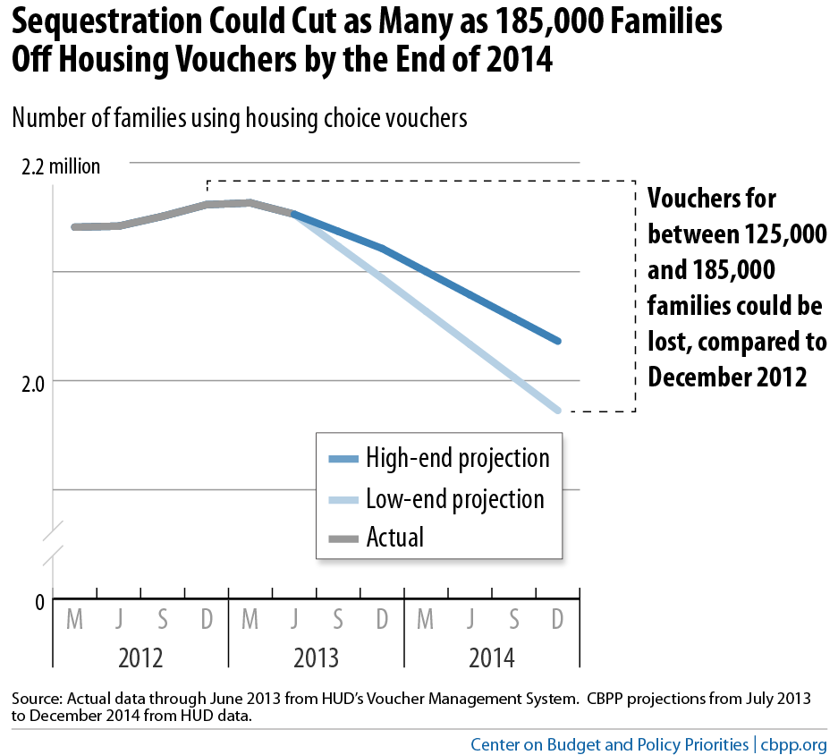
Sequestration Could Cut as Many as 185,000 Families Off Housing Vouchers by End of 2014

Slide 14
Possible Impacts of Inadequate Full-Year CR
Many PHAs will need to continue or begin attrition policy and possibly reduce average voucher cost.
CBPP estimates 125,000 – 185,000 fewer families will receive HCV assistance by Dec. 2014 compared to Dec. 2012.
2,100 – 3,300 estimated loss of vouchers in MA
Important that any cost-reduction policies adopted now be easy to reverse if Congress increases funding for 2014.
Should know whether increase is likely by mid-December, and final amount by mid-January.
Notes:
MA cuts are below the 76,524 vouchers leased in MA as of December 2012.

Slide 15
2014 HCV Funding Goals
To restore lost vouchers and cancel cost-savings measures need renewal eligibility is based on the higher of 2012 or 2013 spending.
“Higher of” policy is fair to both PHAs that were forced to reduce spending in 2013 due to inadequate reserves and to PHAs that used reserves to maintain number of families served.
CBPP estimates full renewal funding under “higher of” policy at $17.7B.
At Senate level of $17.568B, proration at about 99.4%.
Senate Admin. Fee level of $1.69M = proration at ~ 82%.
Notes:
Higher of estimate is about $100M above Senate.

Slide 16
Using Historical Voucher Data to Show Harm
State fact sheets with data on individual PHAs from 2004 – 2012 at http://www.cbpp.org/cms/index.cfm?fa=view&id=3586#National
Include CBPP’s estimate of vouchers lost in 2014 in each state if a full-year CR continues HCV funding at 2013 post-sequestration level.
Need local stories to document and publicize real harm of sequestration in 2013 – and in 2014 if not reversed.
To build allies, fact sheets highlight the total received by landlords in each state in 2012 through the HCV program.

Slide 17
Making the Case
Critical to document and publicize real harm of sequestration in 2013 – and in 2014 if not reversed. Both data and stories are important.
Any agreement to fix defense sequestration must also restore funding for housing and other nondefense programs
Key principle of any deal: should protect low-income Americans and avoid increasing poverty or hardship
Don’t replace sequestration with other cuts to low-income programs
16
Notes:
In documenting harm of sequestration, important to consider not only what’s happening now, but what would likely happen in 2014 if funding is not restored.

Slide 18
Useful CBPP Resources
Report on sequestration and House/Senate FY 2014 HUD funding bills, including state-by-state data on impact of funding cuts in major HUD programs, 2010 – 2013: http://www.cbpp.org/cms/index.cfm?fa=view&id=3993
State-by-state data on HUD rental assistance programs, the families they serve, and unmet needs: http://www.cbpp.org/cms/index.cfm?fa=view&id=3586
Lots of info on issues related to the broader budget fight: http://www.cbpp.org/research/index.cfm?fa=topic&id=29
17

