Slide 1
Effective Messaging?? What’s In THEIR Interest!!
New England Housing Network
Dec. 6, 2013
David Fink, Policy Director
Partnership for Strong Communities

Slide 2
The Only 4 Questions!
Who’s the audience?
What’s the goal?
What’s the message?
What’s the medium?

Slide 3
The Audience
Internal?
Partners
State policymakers
External?
Municipalities
Residents
Grass Roots
Students

Slide 4
The Goal
To Message or Not To Message?
That is the Question!!
Messaging: A Means, not an End!
Educate?
Establish credibility?
Spark action?

Slide 5
The Message
NEVER – or RARELY – because it’s “the right thing to do.”
ALWAYS because it’s “in your interest to do it… and here’s why.”
Towns: demog/econ needs, grand lists, volunteers
Partners/Allies: more labor pool, more riders, less energy use and emission, less congestion, smaller achievement gap

Slide 6
It’s Not What You Say, It’s How You Say It!
Race vs. Income
Occupations & Incomes
Confronting Fears

Slide 7
The Medium
Appealing to Students, Zoning Commissioners
http://www.pschousing.org/news/rent-roulette

Slide 8
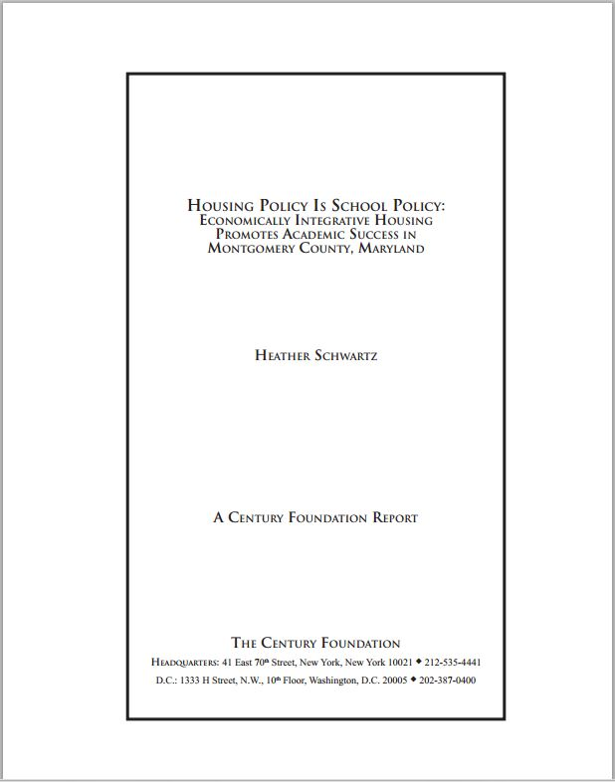
The Medium
Establishing Credibility

Slide 9
The Medium
Educating

Slide 10
More Questions?
David Fink
Policy Director Partnership for Strong Communities 227 Lawrence Street Hartford, CT 06106 p. 860.244.0066 | c: 860.202.7418
david@pschousing.org
www.pschousing.org

