Slide 1
Housing, Health and U.S. Health Reform: New Opportunities for Convergence
Programs in Leadership Development
John E McDonough, DPH, MPA
Harvard School of Public Health
October, 2013

Slide 2
Presentation Outline
Why US health reform?
What does the Affordable Care Act do?
Generally and connections to housing
New Opportunities to Align Housing and Health
Coverage and Access
Delivery System Reform and Global Payments
Public Health/Prevention/Wellness

Slide 3
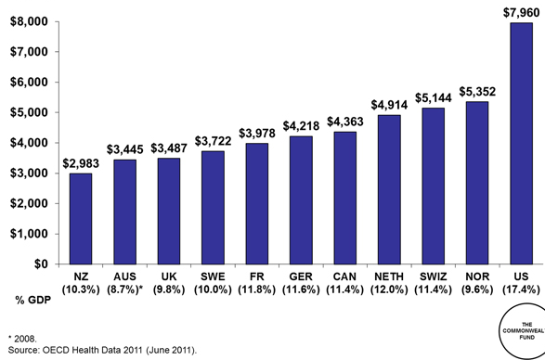
Health Spending Per Capita, 2009 Adjusted for Differences in Cost of Living
Notes:
First, the US just spends a lot of money on medical care. For every dollar we spend, Norway spends about 67 cents.

Slide 4
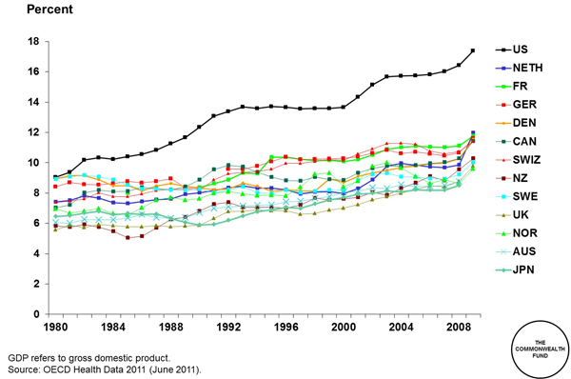
Health Spending as Share of GDP
Notes:
Here’s another way to look at it over time. What you see is that the US has always been among the most expensive, but it’s really only since 1980 that we broke away from everyone else. So why does our system cost so much?

Slide 5
Overall Health System Performance Ranking
Country Rankings
 | 1.00–2.33
 | 2.34–4.66
 | 4.67–7.00
 |  | AUS | CAN | GER | NETH | NZ | UK | US
OVERALL RANKING (2010) |  | 3 | 6 | 4 | 1 | 5 | 2 | 7
Quality Care |  | 4 | 7 | 5 | 2 | 1 | 3 | 6
Effective Care |  | 2 | 7 | 6 | 3 | 5 | 1 | 4
Safe Care |  | 6 | 5 | 3 | 1 | 4 | 2 | 7
Coordinated Care |  | 4 | 5 | 7 | 2 | 1 | 3 | 6
Patient-Centered Care |  | 2 | 5 | 3 | 6 | 1 | 7 | 4
Access |  | 6.5 | 5 | 3 | 1 | 4 | 2 | 6.5
Cost-Related Problem |  | 6 | 3.5 | 3.5 | 2 | 5 | 1 | 7
Timeliness of Care |  | 6 | 7 | 2 | 1 | 3 | 4 | 5
Efficiency |  | 2 | 6 | 5 | 3 | 4 | 1 | 7
Equity |  | 4 | 5 | 3 | 1 | 6 | 2 | 7
Long, Healthy, Productive Lives |  | 1 | 2 | 3 | 4 | 5 | 6 | 7
Health Expenditures/Capita, 2007 |  | $3,357 | $3,895 | $3,588 | $3,837* | $2,454 | $2,992 | $7,290
Note: * Estimate. Expenditures shown in $US PPP (purchasing power parity).
Source: Calculated by The Commonwealth Fund based on 2007 International Health Policy Survey; 2008 International Health Policy Survey of Sicker Adults; 2009 International Health Policy Survey of Primary Care Physicians; Commonwealth Fund Commission on a High Performance Health System National Scorecard; and Organization for Economic Cooperation and Development, OECD Health Data, 2009 (Paris: OECD, Nov. 2009).
Notes:
Here’s an overall ranking on different measures. We spend a lot of time comparing our system with Canada’s, and Canada ends up looking good, only In comparison with us.

Slide 6
The Affordable Care Act and Opportunities to Connect Housing and Health
The ACA’s essential components
New opportunities to align with housing

Slide 7
Housing and Health Connections
Common substandard housing effects:
1 - allergies; 2 - asthma; 3 - lead poisoning; 4 - injuries
2 million hospital ED visits for asthma yearly
2900 people die in house fires yearly
6 million households live with moderate or severe physical housing problems.
Radon is 2nd leading cause of lung cancer death in the U.S.
Children affected more than adults:
Lead affects children’s growing brains; Older houses with lead paint are the primary cause of lead poisoning affecting about 240,000 children in the US
Spillover effects:
Mental Health effects – increased depression
Economic effects – missed workdays
Education effects – missed school days and poor performance

Slide 8
Ten Titles: the ACA’s Architecture
Affordable and Available Coverage– private insurance
Medicaid and CHIP – lower income public coverage
Delivery System Reform and Medicare
Prevention, Wellness, and Public Health
Workforce Initiatives
Fraud, Abuse, Transparency, Comparative Effectiveness Research, and more
Pathway for Biological Similars
CLASS – Community Living Assistance Services & Supports
Revenue Measures
Manager’s Amendments

Slide 9
Key Opportunities for Healthy Housing
Coverage: Many more low-income Americans with health insurance via managed care/global payment
Delivery System Reform: Move away from fee-for- service and toward global payment
Accountable Care Organizations; patient-centered medical homes; readmission penalties; value based insurance design; comparative effectiveness research; CMS Innovation Center
Hospital community benefit standards
Prevention and Wellness:
Prevention Trust Fund ($10B) & community transformation grants
National Prevention Strategy (health in all policies)

Slide 10
National Prevention Strategy-1
National Prevention Strategy/Council: Strategic Directions
Healthy and Safe Community Environments: Create and sustain, communities that promote health/wellness through prevention.
Improve quality of air, land, and water.
Design/promote affordable, accessible, safe, healthy housing.
Maintain a skilled, cross-trained, diverse prevention workforce.
Clinical and Community Preventive Services: Ensure that health care and community prevention efforts are available, integrated, and mutually reinforcing.
Support community-based preventive services and enhance linkages with clinical care.
Reduce barriers to clinical/community preventive services among at-risk populations.
Coordinate/integrate clinical, behavioral, and complementary health strategies.

Slide 11
National Prevention Strategy-2
Empowered People: Support people in making healthy choices.
Provide people with tools/information to make healthy choices.
Promote positive social interactions and support healthy decision making.
Empower people/communities to plan/implement prevention policies and programs.
Improve education and employment opportunities.
Elimination of Health Disparities: Eliminate disparities, improve quality of life for all Americans.
Ensure a strategic focus on communities at greatest risk.
Reduce disparities in access to quality health care.
Increase the capacity of the prevention workforce to identify and address disparities.
Support research to identify strategies to eliminate disparities.
Standardize and collect data to identify and address disparities.

Slide 12
Suggestions for You
Familiarize yourselves with aspects of health reform that advance better housing and communities
Start conversations with:
Health insurance companies
Hospital systems
State government and localities with forward thinking leadership
The public health community
Start a new roundtable on housing and health (or health and housing)
Recognize that we’re in a new era with new opportunities

